Slide 1
Intro to Spark
By Aaron Merlob (edited and adapted to python by Ryan Henning)
Notes:
… and other edits by Ryan… nothing huge… changed wording, added animations, deleted a few slides, added a few slides, reordered slides, etc. Most of this is Aaron’s original deck.

Slide 2
Agenda
About Apache Spark
Resilient Distributed Dataset (RDD):
Features & Implementation
Sample Functions:
Transformations and Actions
Pair RDDs & More Sample Functions
Code Samples & Mini-Quizzes

Slide 3
Apache Spark
Open-source cluster computing framework
“Successor” to Hadoop MapReduce
Supports Scala, Java, and Python and R!
https://en.wikipedia.org/wiki/Apache_Spark
Notes:
Developed in the AMPLab at UC Berkeley
In-memory primitives outperform on iterative tasks like machine learning algorithms
Disk vs memory tradeoff
almost all API calls are the same between languages

Slide 4
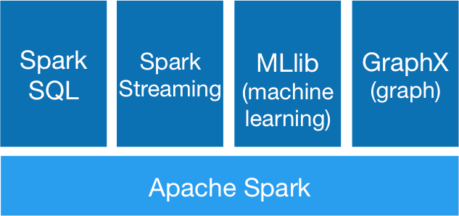
Spark Core + Libraries
https://spark.apache.org
Notes:
This presentation will only consist of the Apache Spark core.

Slide 5
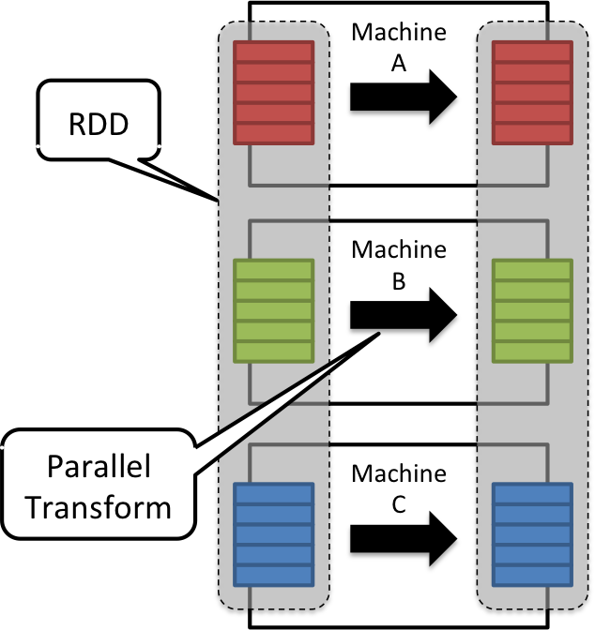
Resilient Distributed Dataset
http://horicky.blogspot.com/2013/12/spark-low-latency-massively-parallel.html
Notes:
This is the main idea. Distribute data into several partitions and spread those across several machines (nodes). Every machine holds its partitions in memory. The RDD is the entire dataset that is distributed across the nodes. You can see how this will speed up computation a lot for simple transformations like in this picture! We’ll talk more about transformations shortly.

Slide 6
RDD - Main Abstraction
Resilient Distributed Dataset (RDD)
Distributed Collection
Fault-tolerant
Parallel operation - Partitioned
Many data sources
… warning: bad puns coming (blame Aaron)
Notes:
We just talked about distributed collection…
Fault-tolerant: Spark can recover automatically if a node fails!
We already talked about how the RDD is stored in partitions.
One cool thing about Spark is that you have a choice which distributed file system you use. Spark doesn’t care, since most of the time it is handing in-memory operations, there isn’t much pressure on the disk anyway. This is in stark contrast to Hadoop where you have to use HDFS and the pressure on the disk is enormous.

Slide 7
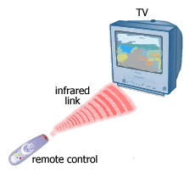
RDDs are Immutable
Immutable
Lazily Evaluated
Cachable
Mute

Slide 8

RDDs are Lazily Evaluated
Immutable
How Good Is Aaron’s Presentation?
Lazily Evaluated
Cachable
Notes:
http://ozan.keysan.me/presentations/version_control/images/meh.jpg

Slide 9
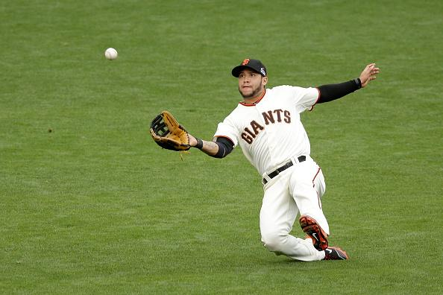
RDDs are Cachable
Immutable
Lazily Evaluated
Cachable
Notes:
http://cache4.asset-cache.net/xc/457217854-gregor-blanco-of-the-san-francisco-giants-catches-a-fly.jpg?v=2&c=IWSAsset&k=2&d=GkZZ8bf5zL1ZiijUmxa7QfB9aHnDwTe3CV6f4J3Wd0LQe-nZ5luNVDDM-lJ9riYb0&b=ODU2

Slide 10
Mechanical Sympathy
“You don’t have to be an engineer to be be a racing driver, but you do have to have Mechanical Sympathy.” – Jackie Stewart, racing driver
Notes:
This is especially true for spark. If you don’t have sympathy for the system, you’ll write code that is not efficient and will tax your hardware and take forever to run. You need to know a little bit about how Spark works so that you can use it correctly, but you don’t need to know the low-level details (unless you want to for fun!).

Slide 11

Distributed Components
http://spark.apache.org/docs/latest/cluster-overview.html
Notes:
The driver program (where the SparkContext lives) will usually run on your laptop. It tells you cluster what to do: it says “jump”, the cluster says “how high?” ... sort-of thing.
The cluster manager might live on the same machine as one of your workers. Or it might be a stand-alone node. Either way the cluster manager’s job is to schedule task on the workers and to restart tasks if one of your works dies.
The works are the nodes that do the heavy of collectively crunching all the data.

Slide 12
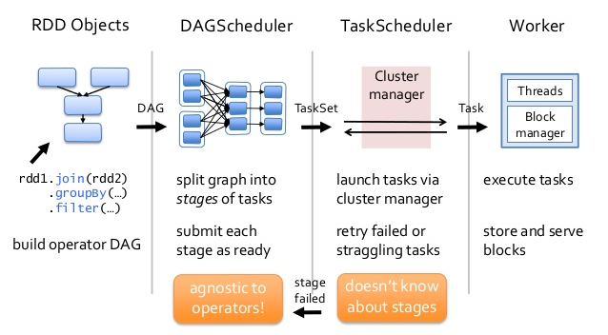
Scheduler Process
https://cwiki.apache.org
Notes:
DAG = Directed Acyclic Graph (Thanks Cindy Chen for pointing out the first appearance)
You build the DAG in your driver program by applying transformations to RDDs.
The DAG scheduler then figures out how translate the DAG into stages with small tasks.
Those tasks get sent to the TaskScheduler which runs on the Cluster manager. The cluster managers allocates workers to perform the tasks.

Slide 13
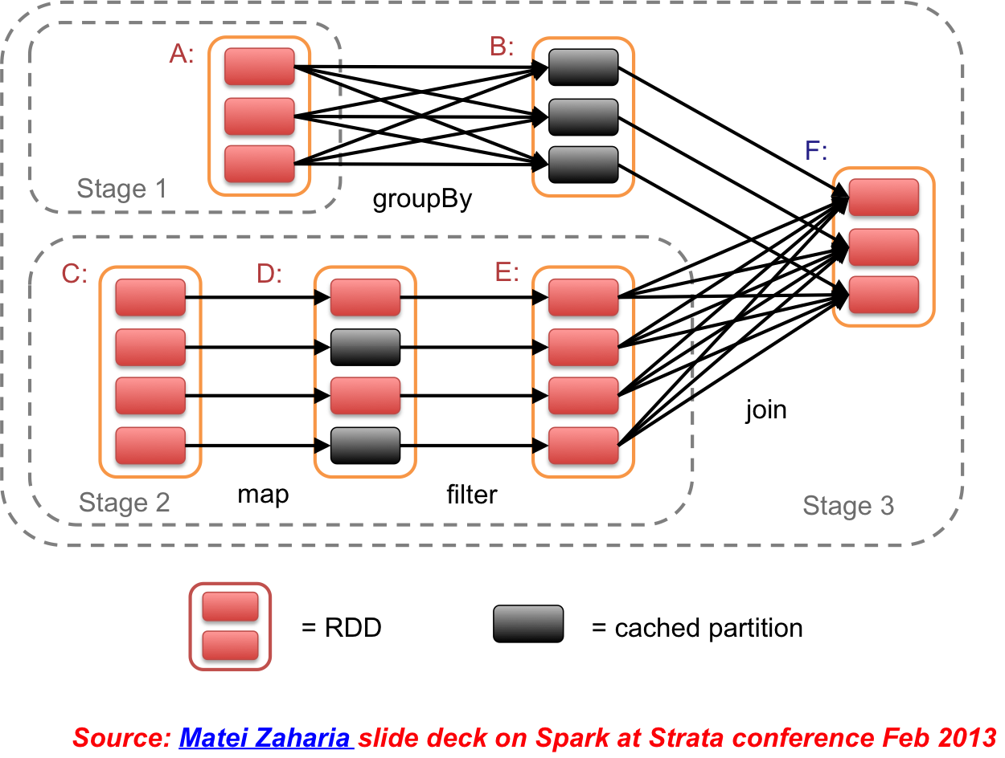
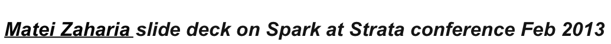
DAG Example
Notes:
Here’s an example of how a DAG is split into stages and tasks.

Slide 14

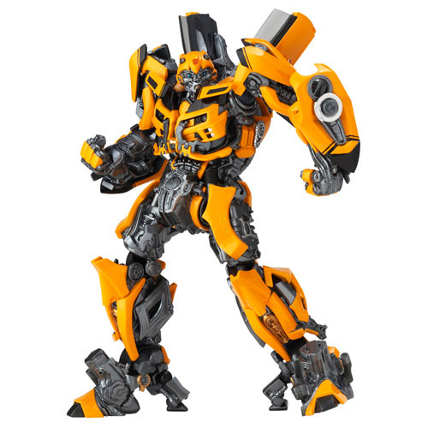
Two types of RDD Operations:
Actions
Transformations
Notes:
You can transform RDDs, but that just adds a node to the DAG… that is, it just puts a step in your pipeline. Nothing is actually computed by transforming an RDD. In this way you can layer transformations without causing any real computation to occur.
Actions actually cause computations to happen. It forces the DAG that was created by the transformations to be executed. Actions actually return real results.
Transformations: Lazily evaluated, add to DAG . Actions - force an evaluation
http://media.archonia.com/images/samples/83/42/128342_s0.jpg
http://vignette2.wikia.nocookie.net/video151/images/e/e1/Qwizards_-_Transformers_Summer_Edition_2014/revision/latest?cb=20140625225455

Slide 15

Four Actions
Collect Count
First Take
Notes:
http://comicsalliance.com/files/2014/03/TMNT-Playmates-Movie-Action-Figures-all-main.png

Slide 16
Collect & Count
Collect - Return all the elements of the RDD as an array at the driver program.
Count - Return the number of elements in the RDD
http://spark.apache.org/docs/latest/programming-guide.html#resilient-distributed-datasets-rdds

Slide 17
First & Take
First - Return the first element in the RDD
Take - Return an array with the first n elements of the RDD

Slide 18

3 Transformations
Filter
Map
FlatMap

Slide 19
RDD.filter
Applies a function to each element
Returns elements that evaluate to true
RDD
∎
∎
∎
…
∎
RDD
∎
…
∎
Notes:
Return a new dataset formed by selecting those elements of the source on which func returns true.

Slide 20
RDD.map
Transforms each element
Preserves # of elements
RDD
∎
∎
∎
…
∎
RDD
∎
∎
∎
…
∎
Notes:
Return a new distributed dataset formed by passing each element of the source through a function func. (Doc)

Slide 21
RDD.flatMap
Transforms each element into 0-N elements
Changes # of elements
RDD
∎
∎
∎
∎
∎
…
∎
RDD
∎,∎,∎
∎
∎,∎
…
∎,∎,∎
Notes:
Similar to map, but each input item can be mapped to 0 or more output items (so func should return a Seq rather than a single item).

Slide 22
Map vs FlatMap - Examples
Alphabet letters (A,B,C) to
NATO Phonetic Letters (Alfa, Bravo, Charlie)
RDD
∎
∎
∎
…
∎
RDD
∎
∎
∎
…
∎

Slide 23
Map vs FlatMap - Examples
Paragraph of words (“Mary had a little lambda”) to individual words
RDD
∎
∎
∎
∎
∎
…
∎
RDD
∎,∎,∎
∎,∎
∎,∎,∎
…
∎,∎,∎

Slide 24
Map vs FlatMap - Examples
Numbers x, transform to the tuple (x, x^2)
RDD
∎
∎
∎
…
∎
RDD
(∎,∎)
(∎,∎)
(∎,∎)
…
(∎,∎)

Slide 25
Pair RDDs
Operations on tuples (key, value)
Offers better partitioning
Exposes new functionality

Slide 26
Reduce & ReduceByKey
Reduce (Action)
Aggregate RDD elements using a function
Returns single element
ReduceByKey (Transformation)
Aggregate Pair RDD elements using a function
Returns Pair RDD
Notes:
Reduce: Aggregate the elements of the dataset using a function func (which takes two arguments and returns one). The function should be commutative and associative so that it can be computed correctly in parallel.
ReduceByKey: When called on a dataset of (K, V) pairs, returns a dataset of (K, V) pairs where the values for each key are aggregated using the given reduce function func, which must be of type (V,V) => V. Like in groupByKey, the number of reduce tasks is configurable through an optional second argument.

Slide 27
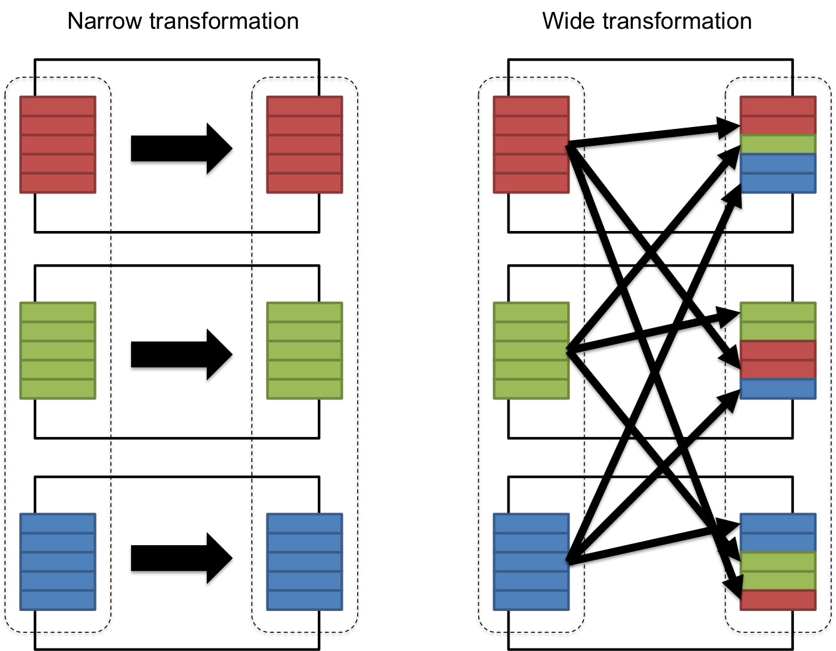
Transformation Complexity
http://horicky.blogspot.com/2013/12/spark-low-latency-massively-parallel.html
Notes:
Examples of narrow operations: filter, map
Examples of wide operations: sortByKey, reduceByKey, groupByKey

Slide 28
Code Examples (python)
Map, Collect:
data = sc.parallelize([1, 2, 3])
mapped_data = data.map(lambda x: x**2)
x = mapped_data.collect()
What is x’s value and type?
Notes:
What is x’s value and type?
x is a list that equals [1, 4, 9]

Slide 29
Code Examples (python)
FlatMap, Take:
data = sc.parallelize([1, 2, 3])
flat_data = data.flatMap(lambda x: range(0, x))
x = flat_data.take(4)
What is x’s value and type?
Notes:
What is x’s value and type?
x is a list that equals [0, 0, 1, 0]

Slide 30
Code Examples (python)
Reduce, Count:
data = sc.parallelize([1, 2, 3])
flat_data = data.flatMap(lambda x: range(0, x))
c = flat_data.count()
r = flat_data.reduce(lambda a, b: a + b)
What is c’s value and type?
What is r’s value and type?
Notes:
What is c’s value and type? 6, int
What is r’s value and type? 4, int

Slide 31
Pop Quiz
What is the ‘sc’ in sc.parallelize()?
SparkContext.
Given to you when you launch Spark shell
Your way to get data into/out of RDDs

Slide 32
Transformation vs. Action?
data = sc.parallelize( \
["Aaron Merlob", "Ryan Henning", "Aaron Ryan", ""])
words = data.flatMap(lambda s: s.split(" "))
result = words.map(lambda w: (w, 1)) \
.reduceByKey(lambda a, b: a + b)
result.filter(lambda p: 'a' in p[0]).count()
result.filter(lambda p: p[1] > 1).count()
We do redundant work right here!
Notes:
Transformations are in green boxes. Actions are in red boxes. What’s wrong with this… performance-wise?

Slide 33
Transformation vs. Action?
data = sc.parallelize( \
["Aaron Merlob", "Ryan Henning", "Aaron Ryan", ""])
words = data.flatMap(lambda s: s.split(" "))
result = words.map(lambda w: (w, 1)) \
.reduceByKey(lambda a, b: a + b).cache()
result.filter(lambda p: 'a' in p[0]).count()
result.filter(lambda p: p[1] > 1).count()
This prevents the redundant work.
Notes:
This fixes it!

Slide 34
What did we learn?
Spark coordinates multiple computers.
RDDs are immutable and lazily evaluated.
Transformations build a plan of attack (DAG).
Actions force an evaluation (produce answers).
Developers designate what they want to cache!
The Spark shell gives you a SparkContext (‘sc’).

Slide 35
Live Demo
With `pyspark` shell. It creates the SparkContext (sc) for you!
With iPython notebook. You’ll have to create the SparkContext yourself. (Unless you do fancy things with iPython notebook…)

Slide 36
tmux
Live demo...

Slide 37
APPENDIX

Slide 38
Type Inferred - Comparison
Python shell:
numbers = sc.parallelize([1,2,3])
letters = sc.parallelize([“a”,“b”,“c”])
numbers.map(lambda x: x * x).collect()
letters.map(lambda x: x * x).collect()
Fails at runtime
Notes:
Types are not inferred in python… python will just blow up at runtime… which is the norm for python errors.

Slide 39
Type Inferred - Comparison
Scala shell:
val numbers = sc.parallelize(Seq(1,2,3))
val letters = sc.parallelize(Seq(“a”,“b”,“c”))
numbers.map(x => x * x).collect()
letters.map(x => x * x).collect()
Fails at compile-time
Notes:
Types ARE inferred in Scala. Yay compiled languages...

